Slide 1
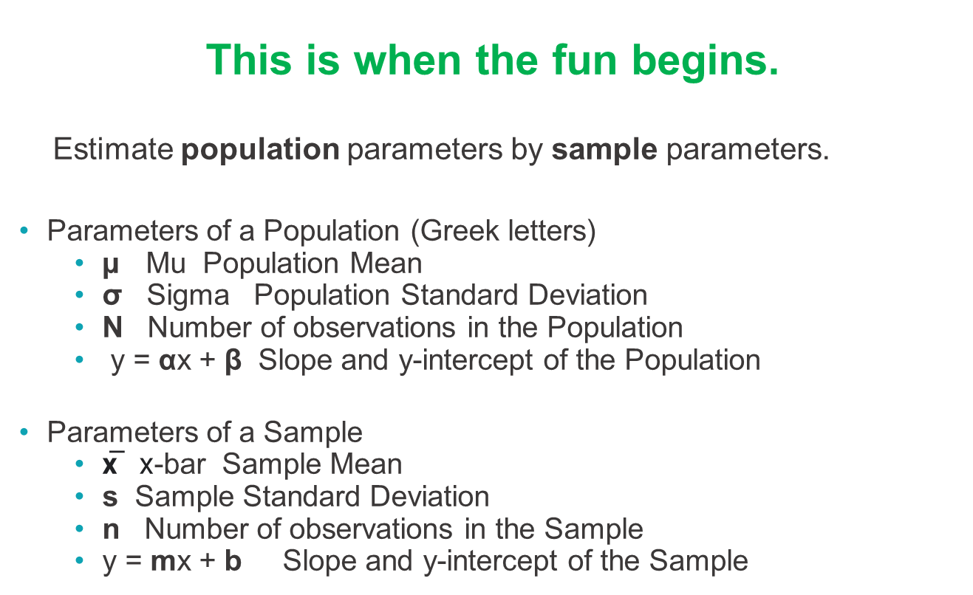
INFERENTIAL STATISTICS
This is when the fun begins.
Estimate population parameters by sample parameters.
Parameters of a Population (Greek letters)
µ Mu Population Mean
$\text{σ}$ Sigma Population Standard Deviation
N Number of observations in the Population
y = αx + β Slope and y-intercept of the Population
Parameters of a Sample
x̅ x-bar Sample Mean
s Sample Standard Deviation
n Number of observations in the Sample
y = mx + b Slope and y-intercept of the Sample

Slide 2
CORRELATION
Two variables are correlated if there is a relationship or connection between them.
The statistical notion of correlation is the correlation coefficient.
The population correlation coefficient is Greek letter rho ρ.
The sample correlation coefficient is r.
r is calculated in excel as r = correl(range1,range2). It is between -1 and +1.
r tells us the sign (direction) of the relationship but not how strong the relationship is.
r-squared tells us how strong the relationship is.
It is the % of the variation in y is explained by the variation in x.
See the next slide for examples

Slide 3
CORRELATION SCENARIOS
r = +1 r-square =1.0
Exact positive relationship between x (horizontal axis) and y (vertical axis).
All the variation in y is due to the variation in x.
r = -1 r-square = 1.0
Exact inverse relationship between x (horizontal axis) and y (vertical axis).
All the variation in y is due to the variation in x.
r = 0.7 r-square = 0.5
Positive relationship between x (horizontal axis) and y (vertical axis).
50% of the variation in y is due to the variation in x.
R = 0.0 r-square =0.0
No linear relationship

Slide 4
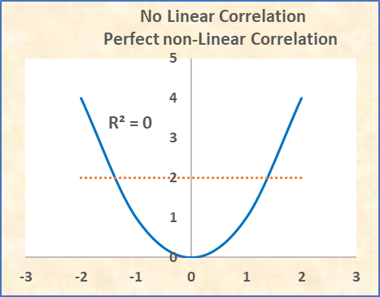
NONLINEAR CORRELATION SCENARIOS
Just because r=0 & r-square = 0 does not mean there is no relationship between x and y.
There is no Linear relationship because the orange line has slope, r, and r-square =0.
But there is a perfect non-Linear relationship on the parabola.

Slide 5
CORRELATION VS. CAUSATION
There may be a correlation between two variables, but that does not
necessarily mean that one causes the other.
Example 1: High correlation, no causation:
Ice Cream sales and baseball homeruns.
Example 2: High correlation with causation.
Weight gain in a rat and amount of food eaten.
PGR charges lower premiums to drivers with high credit scores. This is correlation, but the argument is that people who are responsible with financial decisions are generally more responsible drivers.

Slide 6
CORRELATION VS. CAUSATION – KHAN
Khan Academy
Correlation
Correlation & Causation
Notes:
https://www.khanacademy.org/math/statistics-probability/describing-relationships-quantitative-data/scatterplots-and-correlation/v/correlation-coefficient-intuition-examples
https:/www.khanacademy.org/math/statistics-probability/designing-studies/sampling-and-surveys/v/correlation-and-causality
Instructor & producer(for technical issues) to stay available as ‘office hours’ for any questions.

Slide 7
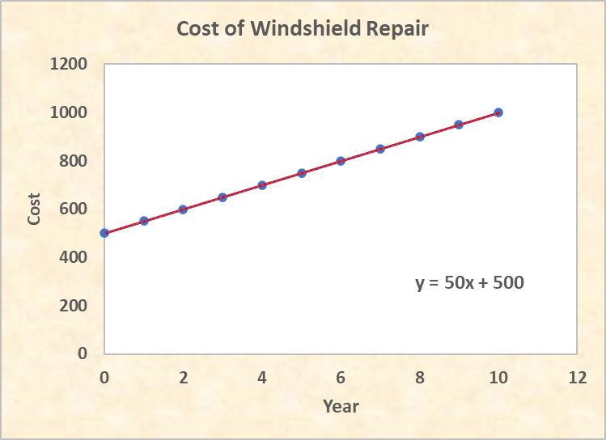
A LINEAR EQUATION IS A STRAIGHT LINE
Slope = 50/year
y intercept = 500

Slide 8
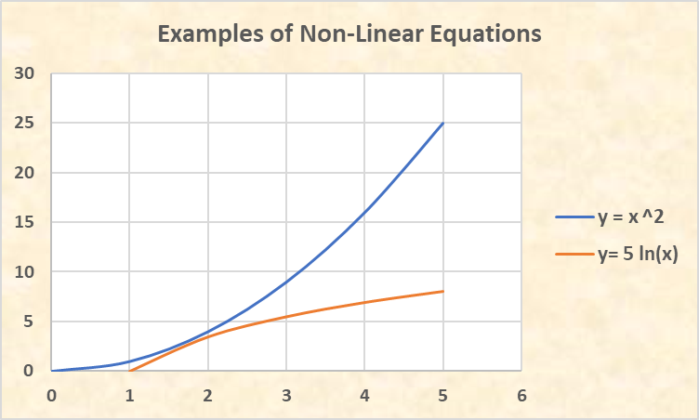
NONLINEAR EQUATIONS ARE NOT STRAIGHT LINES
Examples: y = x^2 y = 5*ln(x)

Slide 9
LINEAR EQUATIONS (TRENDS) CALCULATIONS
A linear equation has the form y = mx + b.
b is the y-intercept: where the line crosses the y axis when x is 0.
m is the slope: the amount y increases when x increases 1 unit.
Method 1 to find the equation y = mx + b: Slope/intercept method
Today’s cost to repair a windshield is $500. The cost increases $50 each year.
How much will a windshield cost to repair 6 years from now?
When x=0, y=$500, so the y-intercept is b = $500.
The cost increases $50 each time x increases by 1, so m = $50.
y = $50x + $500
In year 6: y = ($50)(6) + $500 = $300 + $500 = $800

Slide 10
LINEAR EQUATIONS (TRENDS) CALCULATIONS
Method 2 to find the equation y = mx + b: Two Point Method
Given: (2, 600) and (6, 800) are two points on a line. Find the equation of the line.
x=2, y=600 and x=6, y=800
Compute the slope: (change in y) / (change in x) = (800-600)/(6-2) = 200/4 = 50
So, y = mx + b y = 50x + b
Put either point into the equation to find b: 600 = 50(2) + b 600 = 100 +b b = 500
y = 50x + 500

Slide 11
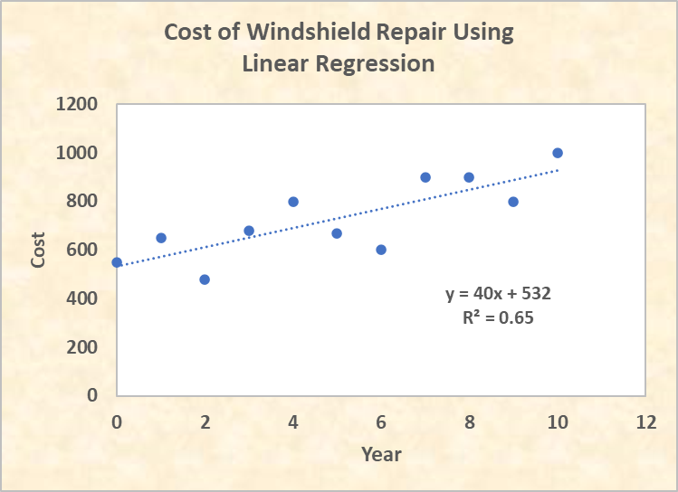
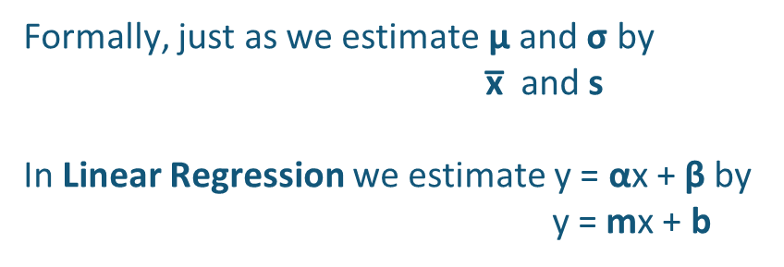
LINEAR REGRESSION
In Algebra, if all the points are on a straight line, the equation is y = mx+ b
In Statistics, the data points are scattered about a straight line. We use Linear Regression to get the formula y = 40x + 532, which is an estimate of the true straight line.
Formally, just as we estimate µ and $\text{σ}$ by
x̅ and s
In Linear Regression we estimate y = αx + β by
y = mx + b

Slide 12
LINEAR REGRESSION
Khan Academy
Linear Regression
Notes:
https://www.khanacademy.org/math/statistics-probability/describing-relationships-quantitative-data/more-on-regression/v/regression-line-example
Instructor & producer(for technical issues) to stay available as ‘office hours’ for any questions.

Slide 13
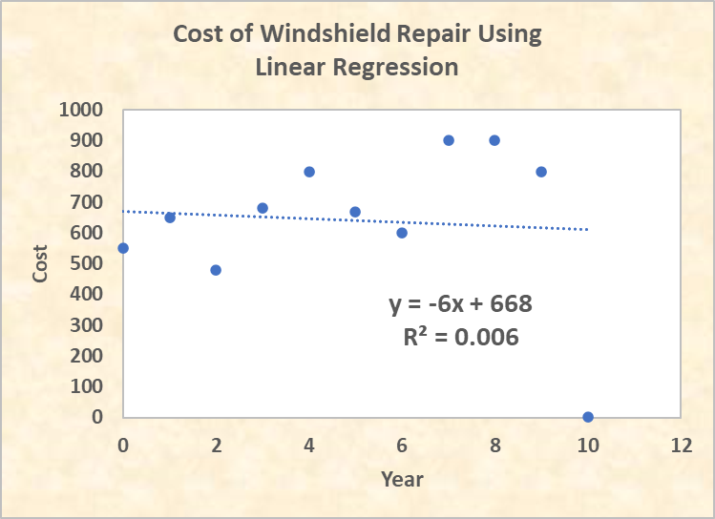
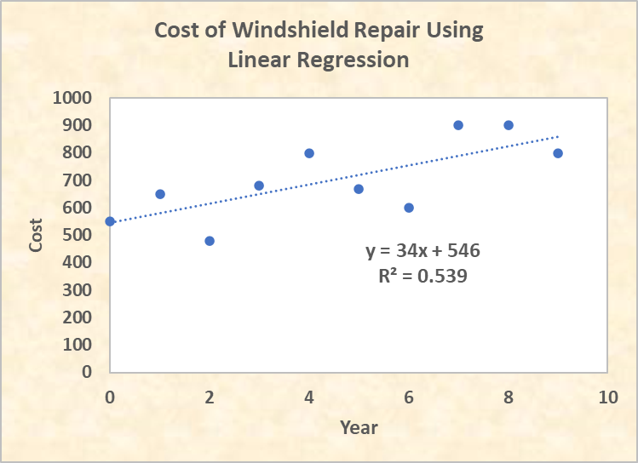
LINEAR REGRESSION - OUTLIERS
If two analysts get different answers, the first place they look is their SQL. But the reason could be the way they handle outliers. The right- hand graph has positive slope because it eliminated the outlier. The left has a negative slope because it did not eliminate the outlier
Outliers can influence the interpretation of a linear regression, even as far as finding a positive or negative slope.

Slide 14
EXCEL EXERCISES
Go to the Excel exercises in your workbook. The answers are to the far right on each tab.
Tabs
MeanMed
Display
Outlr1
Outlr2
Corr1
Corr2
LinEq
LinReg
Outlr_LinReg

